Slide 1
Developing Macroscopic forest equations for The Harvard Forest
Zachary Robbins, Portland State University Robert M Scheller, North Carolina State University Bradley Case, Auckland University of Technology Nick Strigul, Washington State University
Notes:
Something somethings

Slide 2
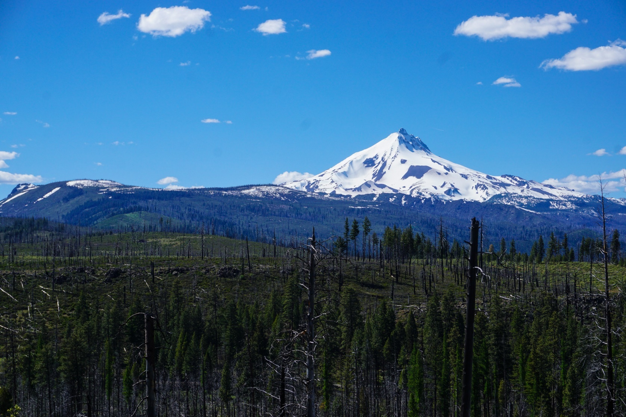
Forest modeling and hierarchy of interactions
Spatially explicit dynamics, such as seed dispersal, light interception, and phenotypic plasticity determine tree competition on scales sometimes less than one square meter.
Events such as wildfire or insect disturbance can occur on scales 10 orders of magnitude larger.
The history and interplay of these dynamics determines landscape conditions and future forest health.

Slide 3
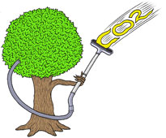
Forests and global carbon
Woody biomass makes up ½ as much carbon as the atmospheric pool.
Changes in climate are expect to alter vegetation patterns through changes in CO2 enrichment, climate stressors, and disturbance regimes.
Many conflicting predictions exist as to whether global vegetation will be a source or sink of carbon.
How this will alter vegetative carbon dynamics is uncertain, but must be accounted for in global or regional climate change models in order for them to be accurate.

Slide 4
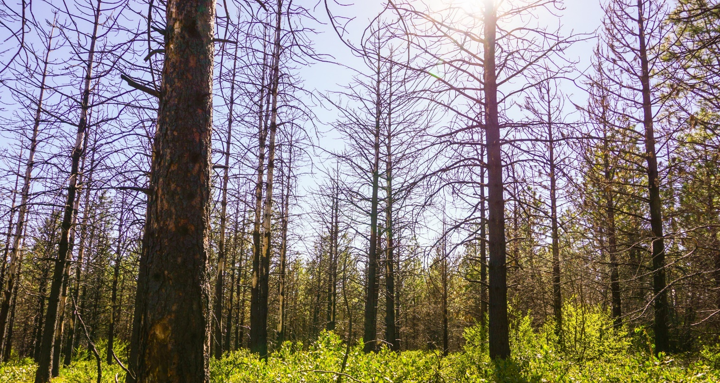
Problems in modeling future forests
Given the complexity and uncertainty of future conditions, models are necessary that both account for local scale changes but are able to be globally applied.
This presents a challenge both in quantification and in computational power.
Models can often not represent every tree in a large landscape, but should still be able to capture emergent dynamics related to change in climate and competition.

Slide 5
Tractable macroscopic equations in forests
Take stand level measurements and create simplified competition equations to apply to larger landscapes.
Allow for the adjustment to stand level changes in competition, growth or disturbance as they are observed.
Currently climate change models take into account coarse vegetation dynamics such as forest type, tractable equations can provide far greater detail.
Can be expanded to the landscape or global systems scale without losing verifiable forest qualities (such as leaf area index, rates of mortality, and growth dynamics).
Global
Stand

Slide 6
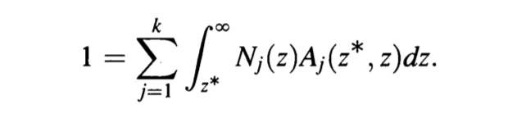
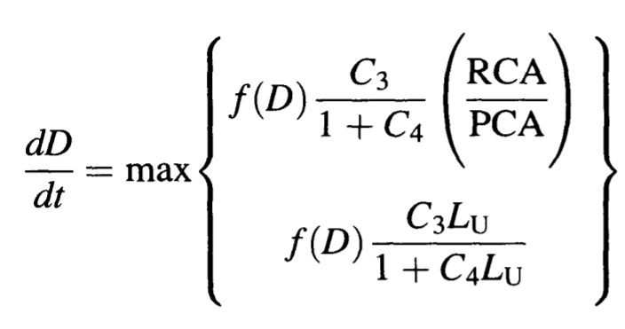
Perfect plasticity approximation (PPA) Strigul et al (2008)
A spatially implicit model that allows for mean-field estimation of the canopy height that separates overstory and understory trees.
This is used to approximate tree growth and competition dynamics by creating cohorts of ideal and light limited growth.
Notes:
Say PPA

Slide 7
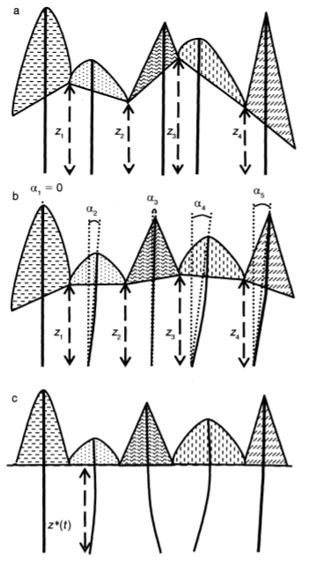
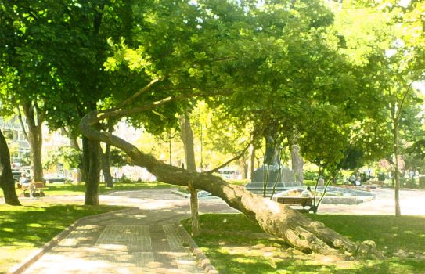
Assumptions on tree properties
The PPA assumes phototropism and canopy tessellation of individual trees negates their specific horizontal location with closed canopy.
The result within a closed canopy is that the distance from the photosynthetic part of a tree to the forest floor becomes normalized as trees tessellate to best maximize light.

Slide 8
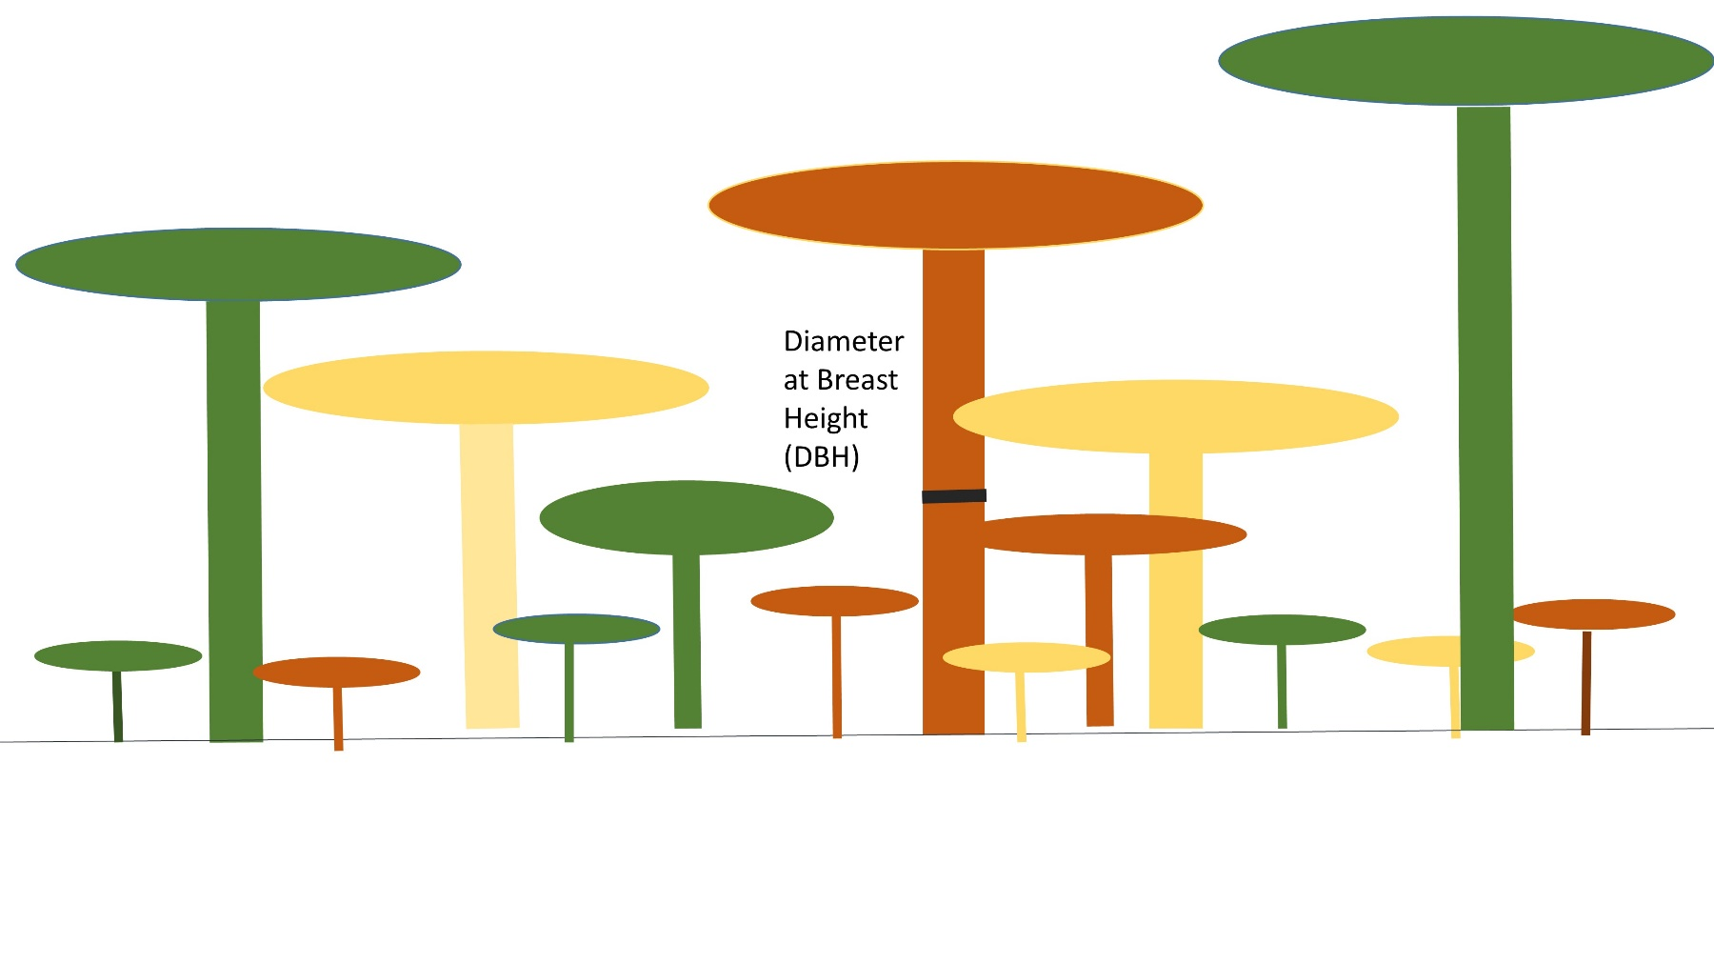
Tree Allometry
Trees are defined within the model by their diameter at breast height(DBH), crown diameter, and height.
DBH is a commonly gathered metric of tree size and growth gathered in forest inventory.
Notes:
Define DBH Tree height Field measured DBH

Slide 9
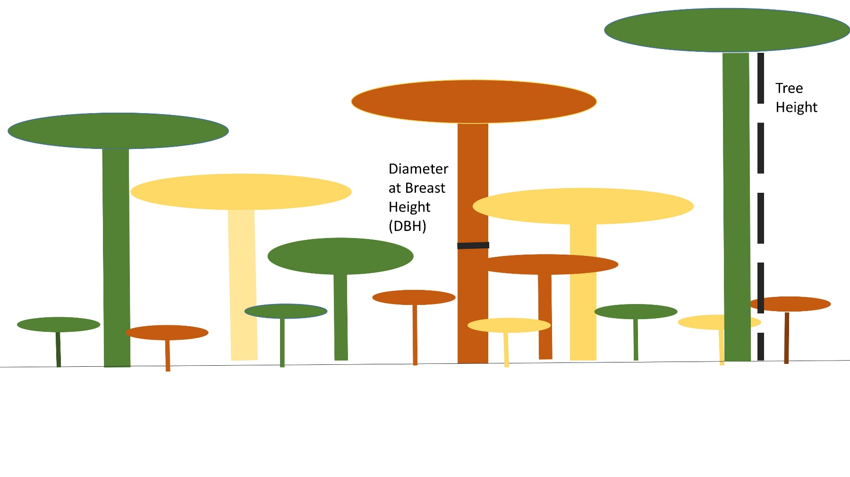
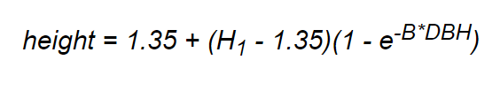
Tree Allometry
Trees are physically defined within the model by their diameter at breast height(DBH), crown diameter, and height.
Height is defined through species specific empirical equations based on the DBH.

Slide 10

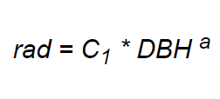
Trees are physically defined by their diameter at breast height(DBH), crown diameter, and height.
Height is defined through species -specific empirical equations based on the DBH.
Crown radius (and crown diameter) is defined in a similar manner.
Through these metrics we can simulate how trees compete with one another for light.

Slide 11
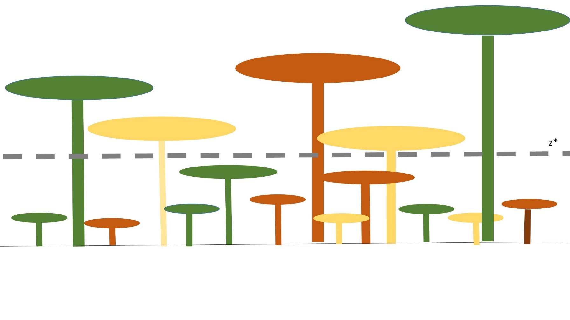
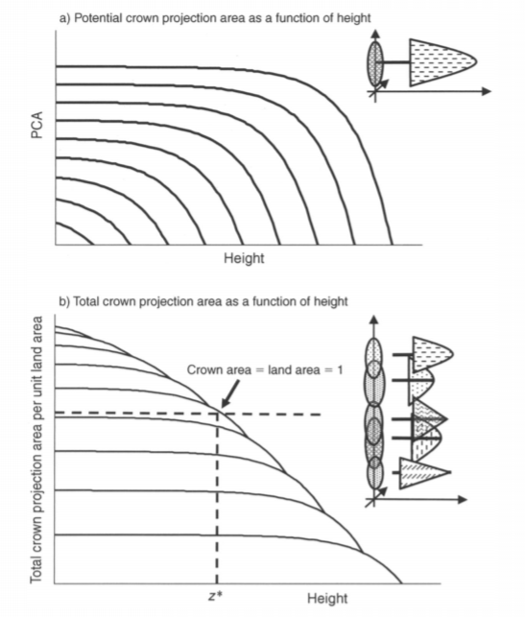
The separation between the overstory and understory is defined by the height at which the cumulative total crown area is equal to the total area of the landscape: z*.
Height cohorts are assigned growth based on the species and whether they receive a theoretical full light or suppressed light based on whether they are above or below the height of z*.
Ideal Growth
z*
Suppressed Growth

Slide 12

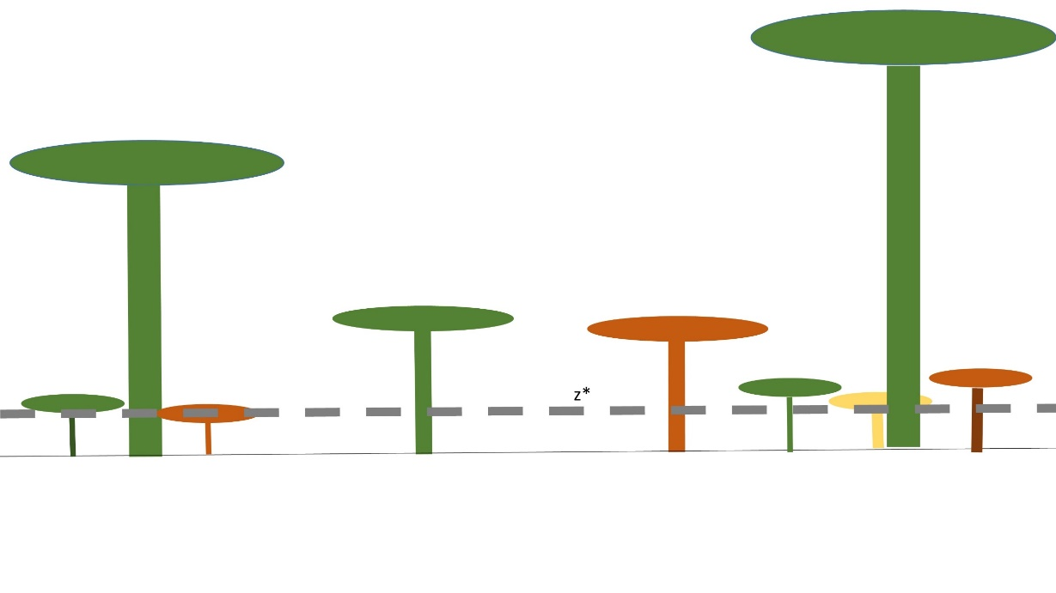
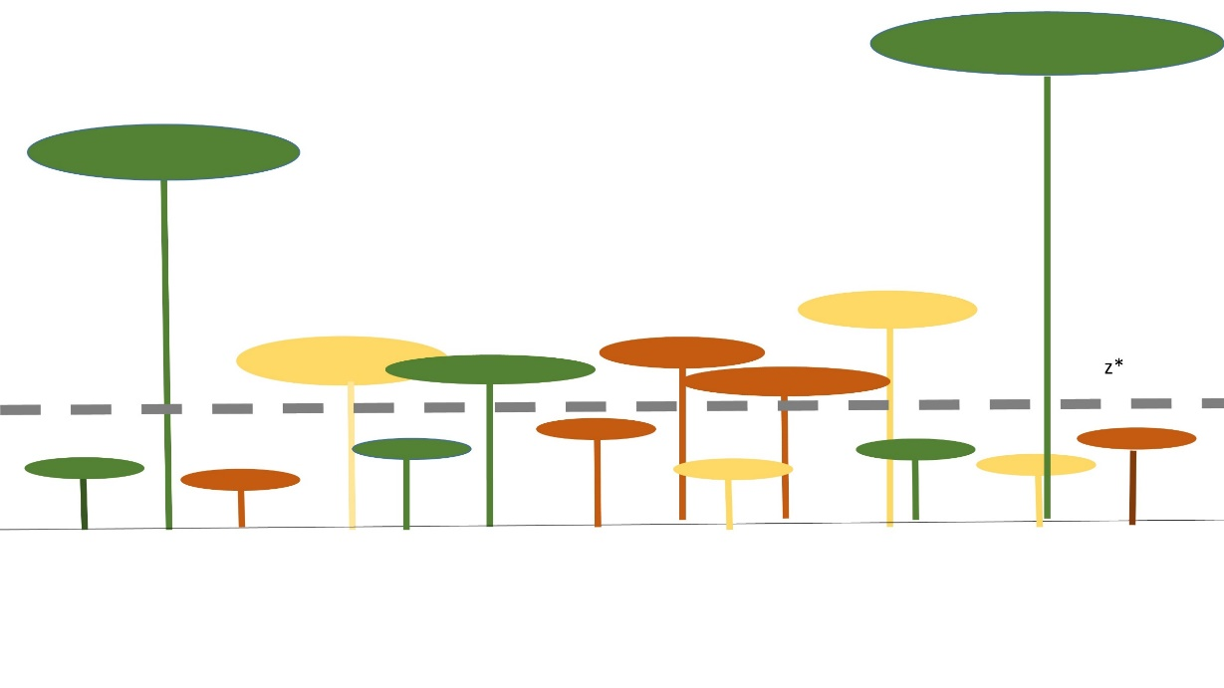
Mortality
z*
z*
z*
Growth
Dispersal

Slide 13
Limitations of the PPA
The spatially implicit design makes validation, calibration, and parameterization difficult to preform.
Has primarily been used on stands that are homogenous in terms of composition and physical environment.
We therefore looked at new methods to parameterize a PPA-macroscopic equation using existing data. The method we choose was parameterizing using a validated spatially-explicit SORTIE model.

Slide 14
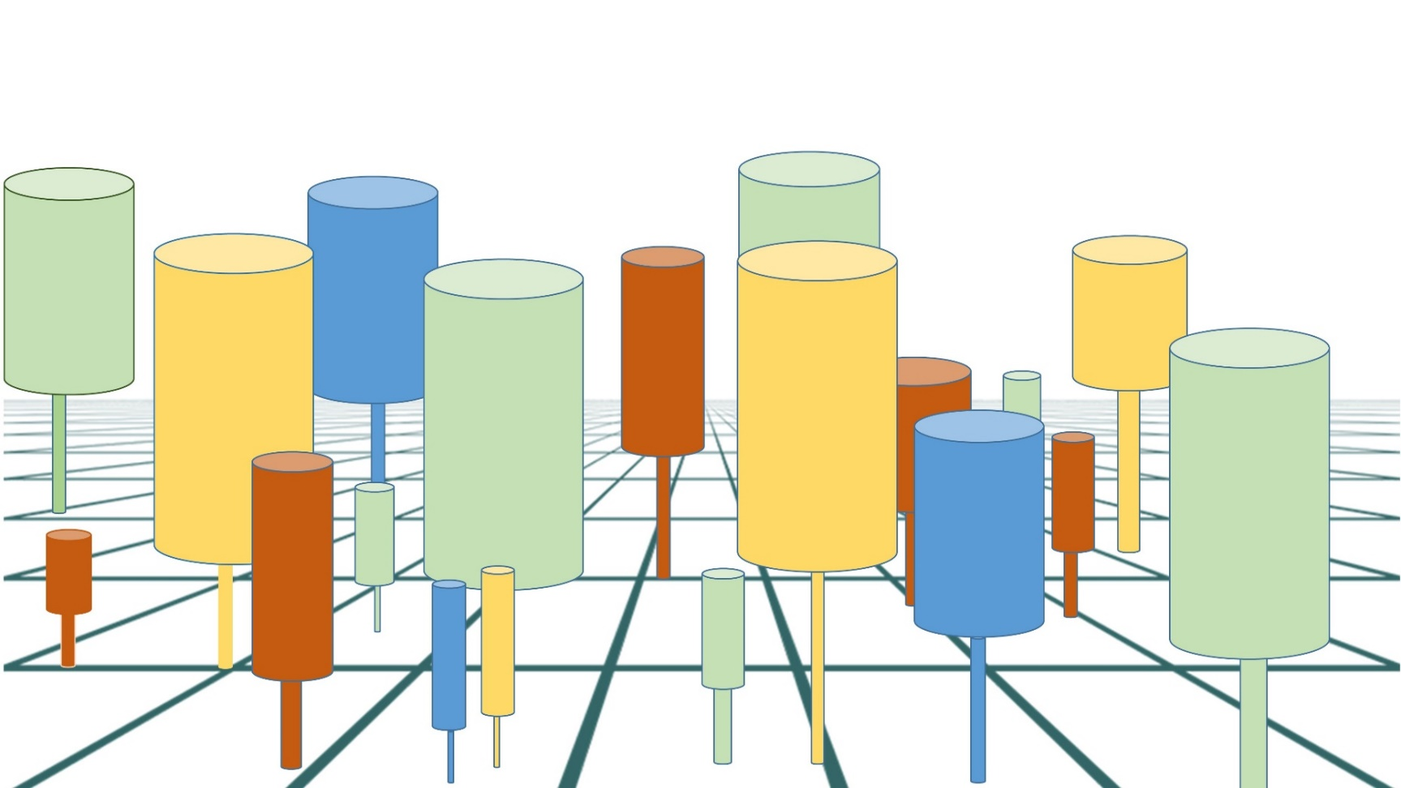
Sortie Model Family Pacala et al. (1996)
A spatially explicit model of competition, with physical locations for trees.
Empirical data determines spatial dynamics of reproduction, mortality and disturbance.
Accounts for conditions of soil such as nitrogen and water availability.

Slide 15
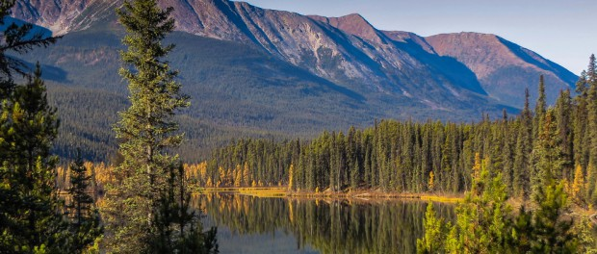
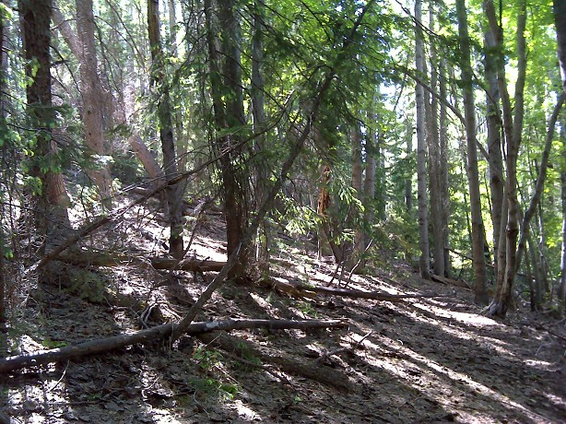
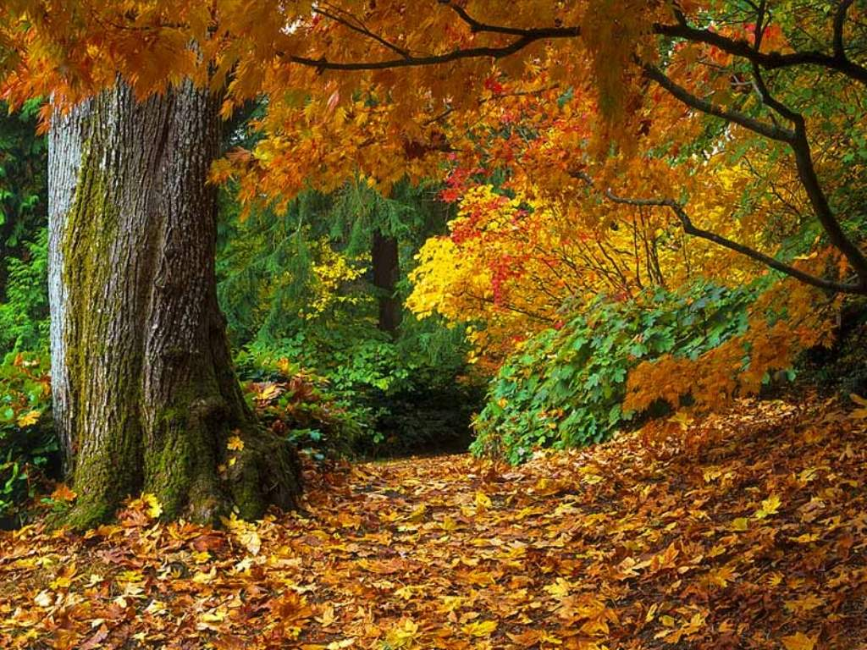
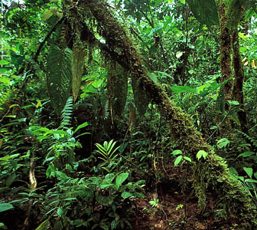
Sortie Model Family Pacala et al. (1996)
Has been parameterized and tested at many locations.
Shown to accurately capture metrics of growth and density, light dynamics, successional patterns.
Currently used and parameterized for boreal and western conifer forests, eastern hardwoods and tropical rainforests.
However, because it is spatially dynamic it is computationally intense for larger landscapes

Slide 16
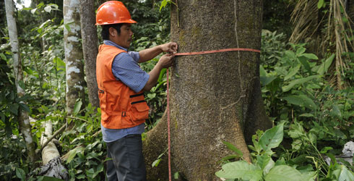
Neighborhood Competition Index Canham et al. 2004
Used to parameterize growth in a SORTIE model.
Used in data sets such as the Forest Inventory and Analysis to parameterize spatially explicit growth equations.
Growth intervals are used to determine tree growth as a function of the spatial relationships of trees.
Potential diameter growth given by the maximum growth of a tree for a given species in a given landscape (similar to PPA’s ideal growth).

Slide 17
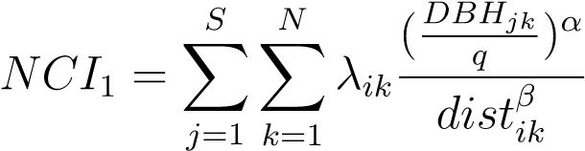
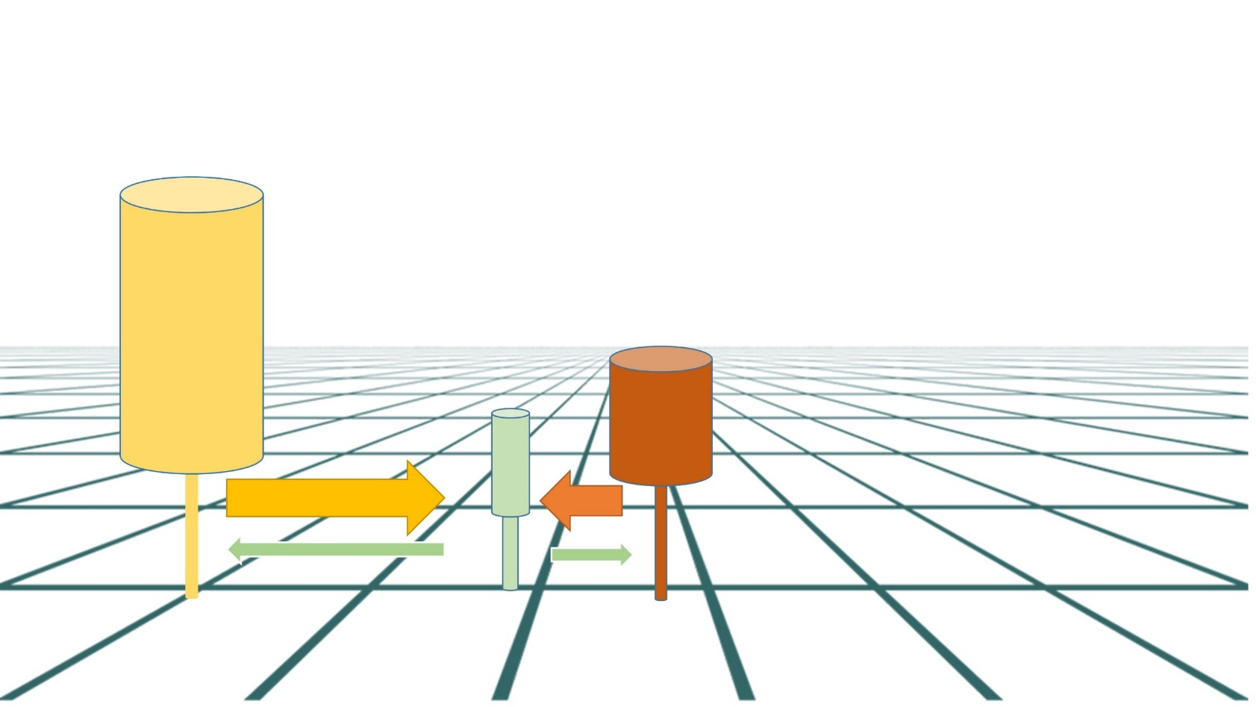
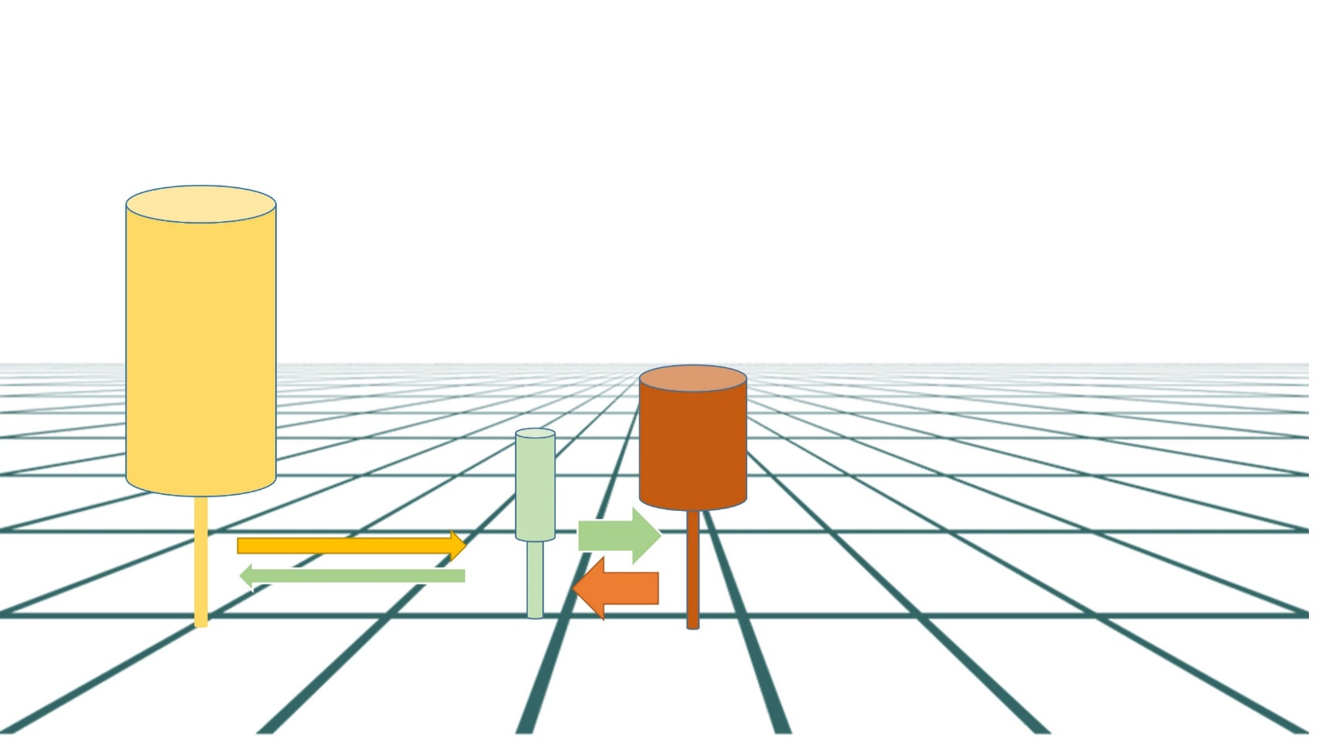
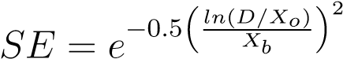
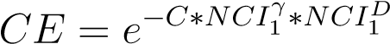
Neighborhood Competition Index Canham et al. 2004
Empirically derived species specific equations of competition based on the size and relative location of trees.
$$Growth=PDG(CE)(SE)$$
Size
Distance

Slide 18
Our goal was to:
SORTIE-ND provides a way to capture the small scale dynamics needed to develop accurate PPA equations.
Develop a method to link stand level data to PPA macroscopic equations using a SORTIE-ND model.
Compare the two models to test PPA’s accuracy on a heterogeneous landscape.
Notes:
Up next: To accomplish this we applied to Harvard forest.

Slide 19
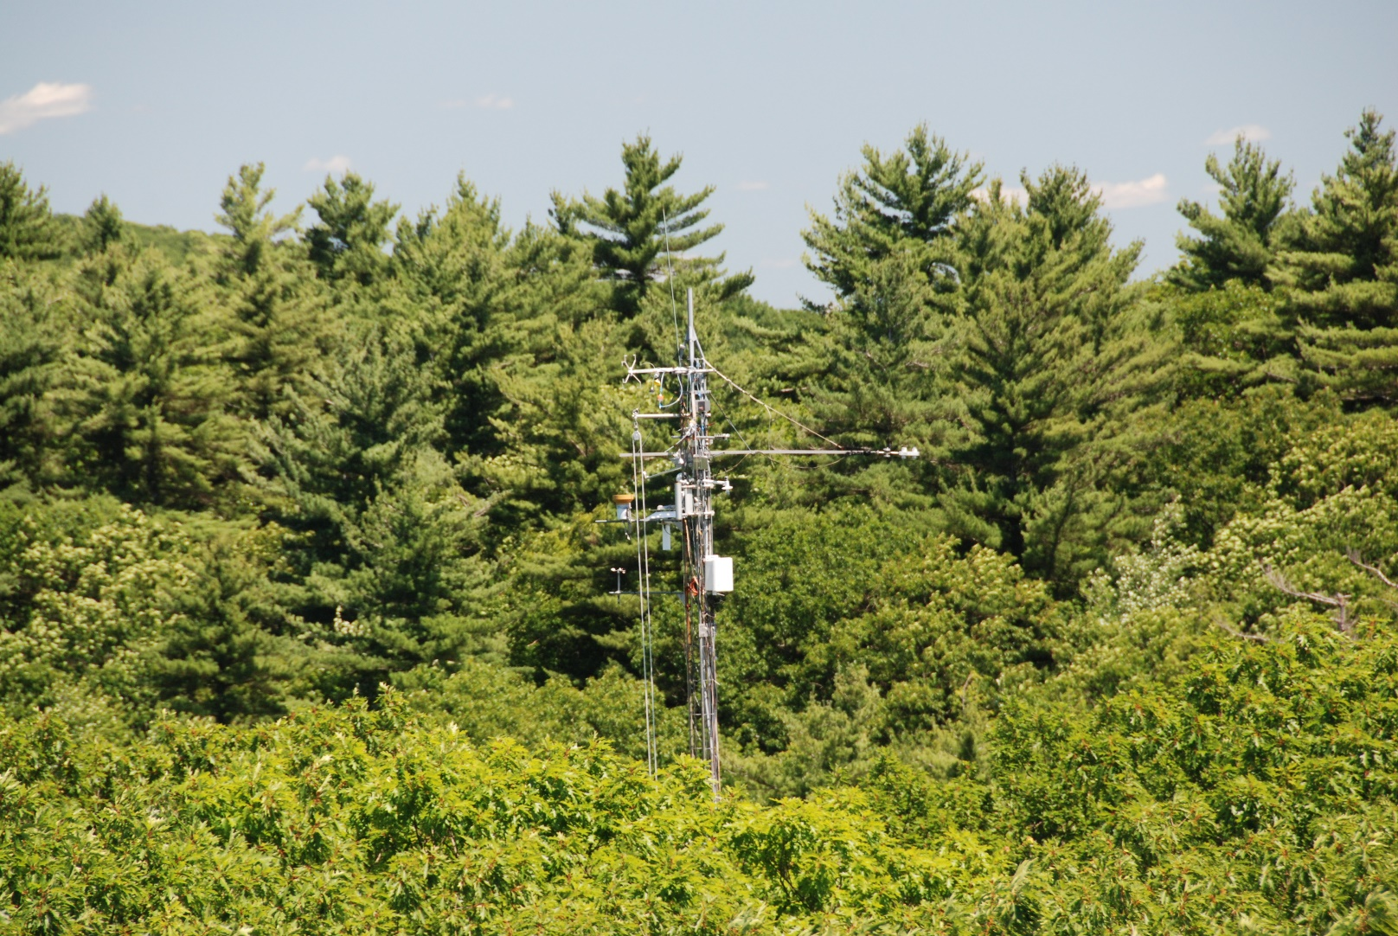
Harvard Forest
Long-term Ecological Research Site in Petersham, Massachusetts established in 1988.
35 hectares consisting of hemlock-mixed hardwoods.
13 tree species present, dominated by eastern hemlock.
A decadal census is preformed on seedlings, saplings and adult trees.
Previously validated SORTIE model from Case et al 2017, found adult diameter class, stem densities and community dynamics similar to that of the census.

Slide 20

Determining Ideal Growth
Within the SORTIE-ND framework we grew one tree in isolation from competition.
Analyzed growth rate per year as function of tree age class (seedling, sapling, adult).
Saplings showed stochastic growth rate, while adults showed linear growth.

Slide 21
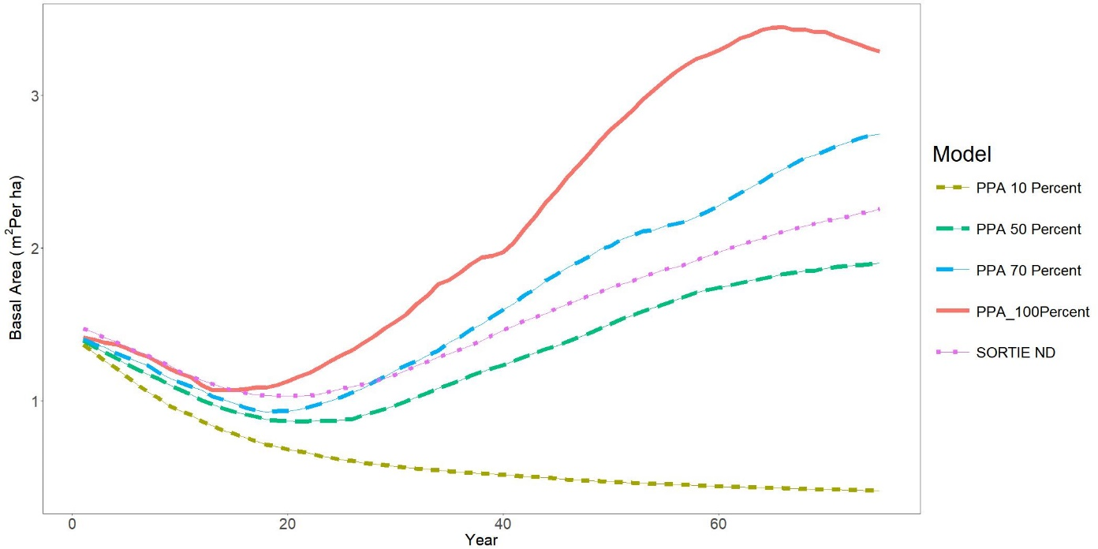
Determining Sapling Growth
Growth of saplings in the SORTIE-ND model was determined additionally by stochastic nitrogen and temperature, making ideal growth difficult to determine.
To better parameterize this rate we conducted several trails of calibration using differing understory suppression.
70 percent of the ideal growth seemed to best capture basal area in the PPA model.
Biomass

Slide 22
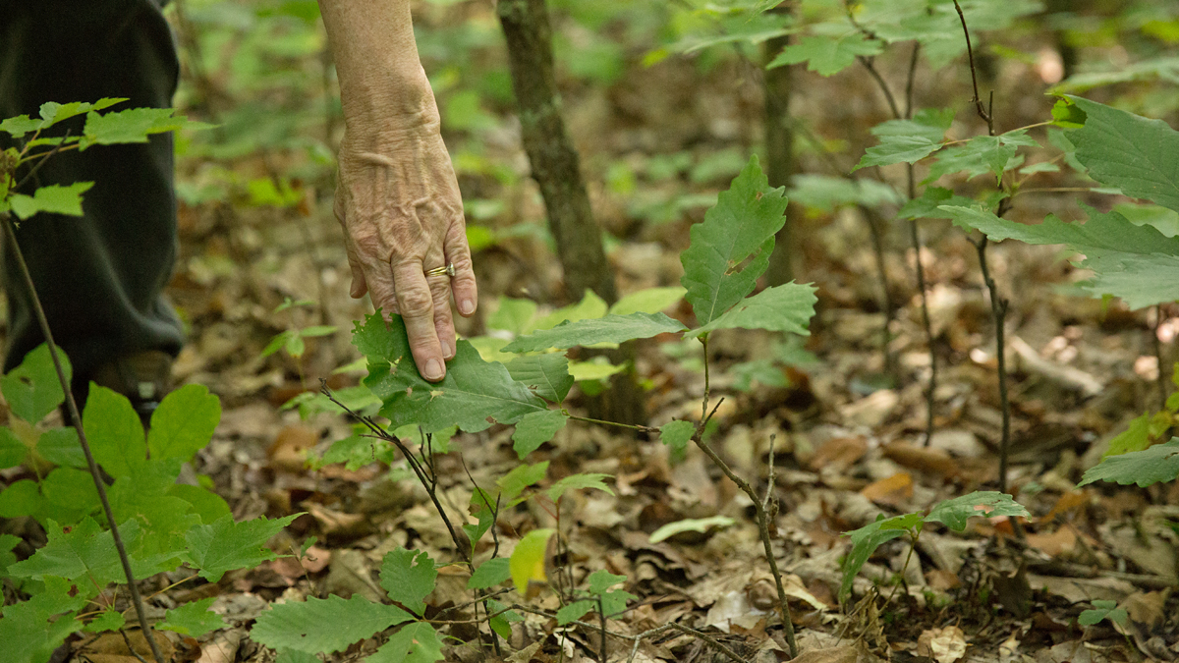
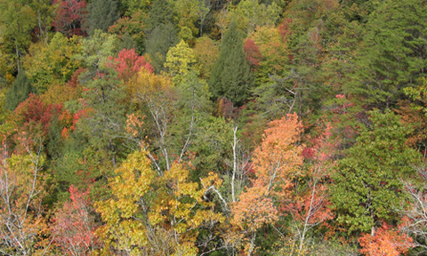
Reproduction and Mortality
A 500 year run of the full SORTIE-ND model was run for Harvard Forest, with all species present.
At each time step and each species, the number of seedlings that transitioned into saplings was determined and used as a mechanistic introduction with the PPA model.
The probability of mortality at any given timestep for adults and saplings at was determined.
This was applied as the probability of mortality for the PPA simulation.

Slide 23
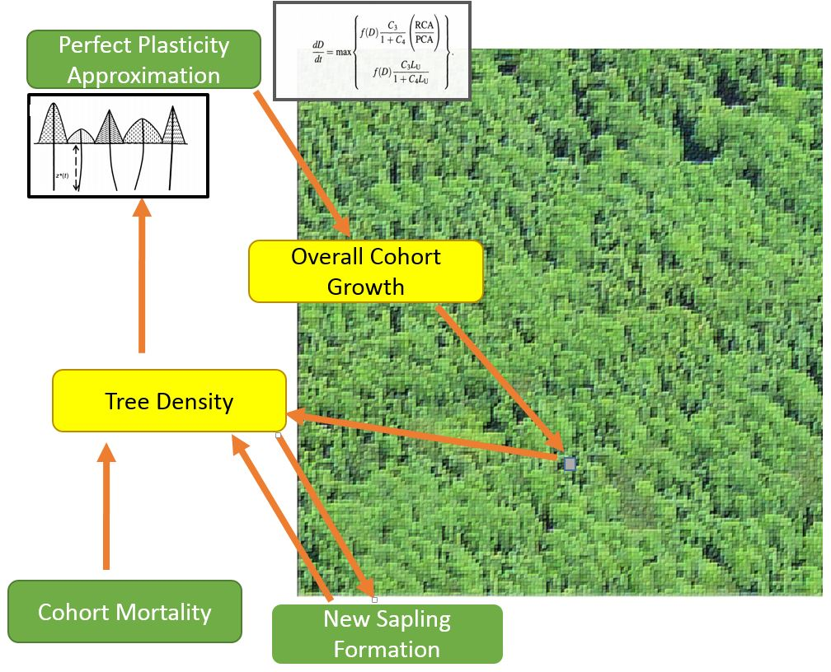
Our PPA algorithm combined the functions of mortality, sapling formation, determination of the perfect plasticity approximation and applied growth. To test the model, we compared
3 replications of SORTIE-ND and PPA models for the Harvard Forest over 200 years.

Slide 24
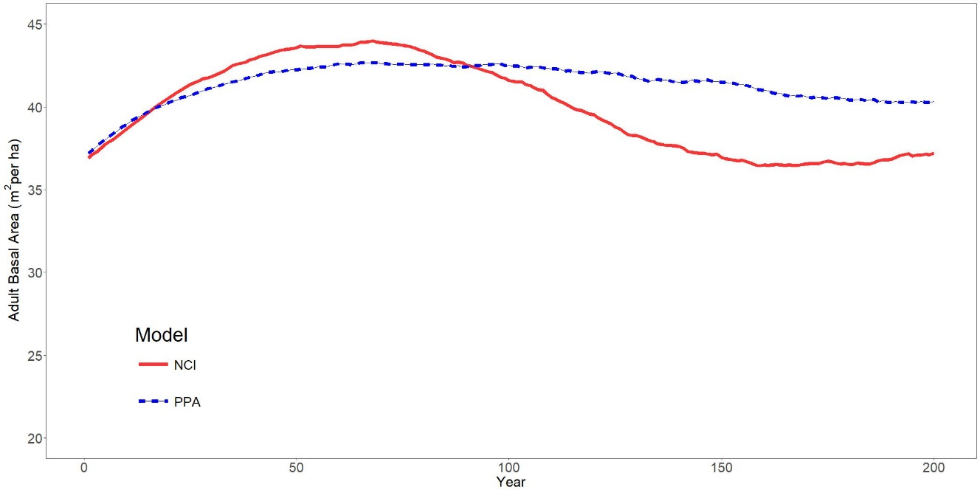
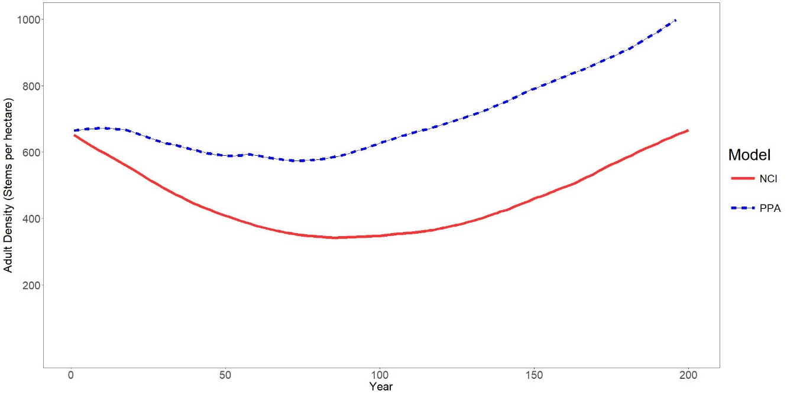
Results: Adult Trees
Biomass
Number of individuals
Model
Model
SORTIE
PPA
SORTIE
PPA
Basal area within 1.5 m² /ha in the first hundred years, within 5 m²/ha in the next 100 years.
Stem densities in the PPA model were consistently higher than the SORTIE-ND model, varying by as much as 200 trees per hectare.
Notes:
Call out color

Slide 25
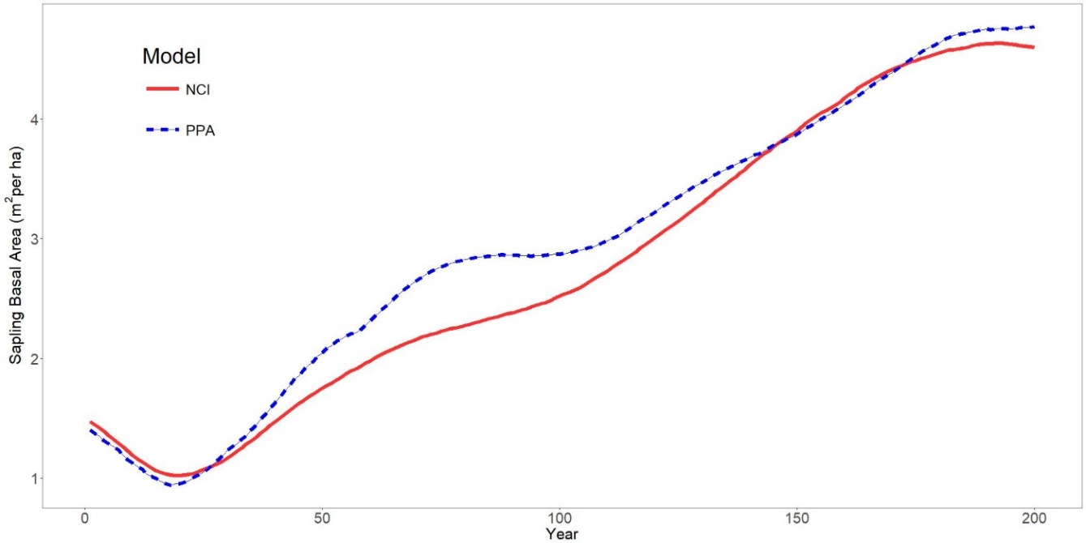
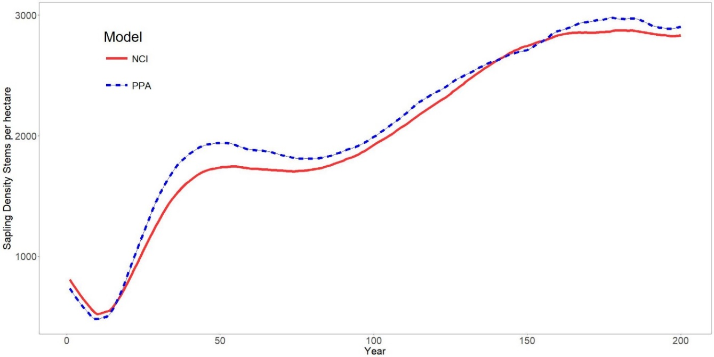
Results: Saplings
Sapling basal area was within .5 m² per ha.
Sapling density was within 100 stems per hectare and had less than a 5% variance.
Biomass
Number of individuals
Model
Model
SORTIE
SORTIE
PPA
PPA

Slide 26
Overall biomass
The simplified PPA model capture major dynamics in biomass and growth levels across a landscape.
PPA model seems to capture sapling density rates, but will over predict the amount of adults on the landscape.
This seems to provide accurate predictions for dynamics such as vegetative carbon content on the landscape.

Slide 27
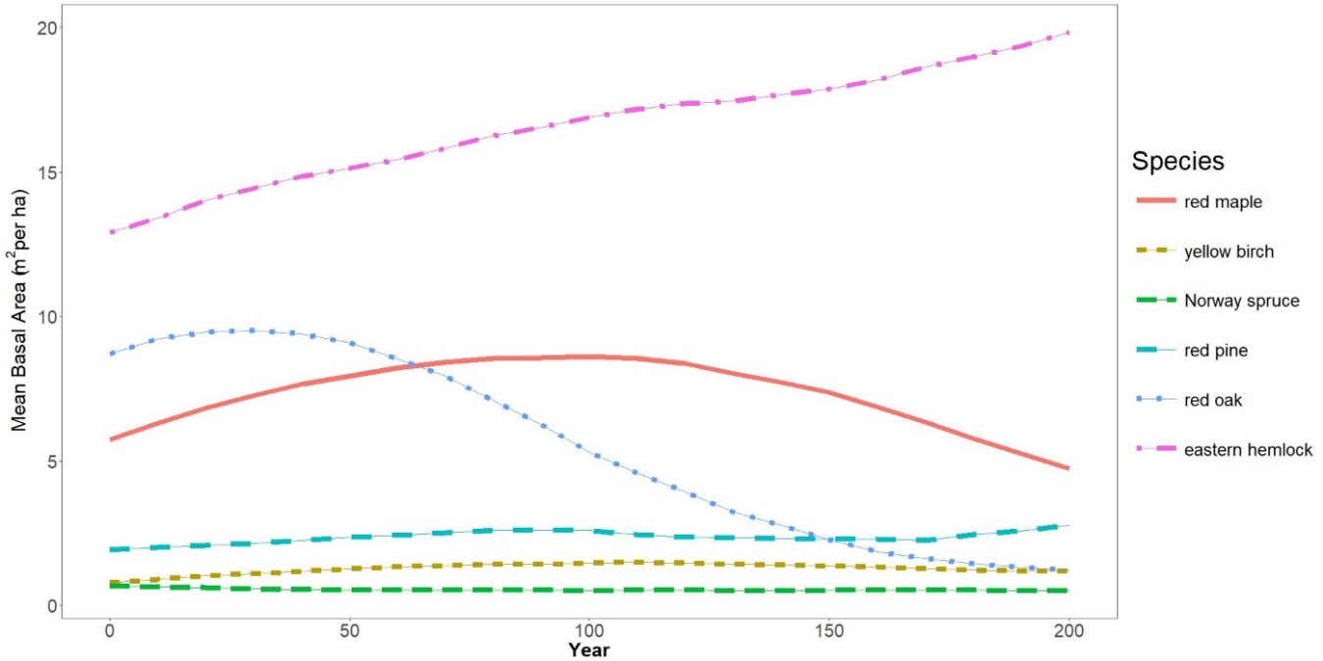
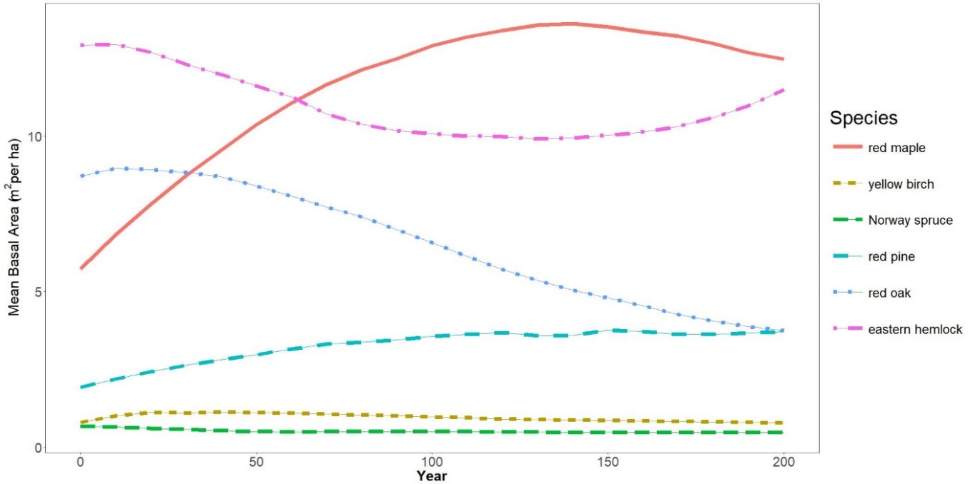
Results: Community Composition
SORTIE-ND
PPA
Community composition varied between the two models.
The SORTIE-ND remained as an eastern hemlock dominated system, while the PPA became a red-maple or co-dominated system.
Barring a major disturbance, previous understanding states that hemlock dominated forests would remain so.

Slide 28
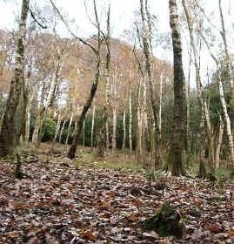
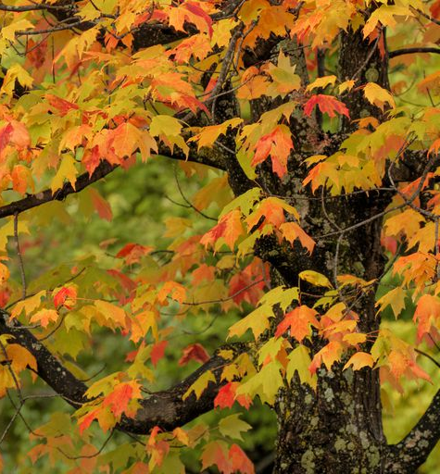
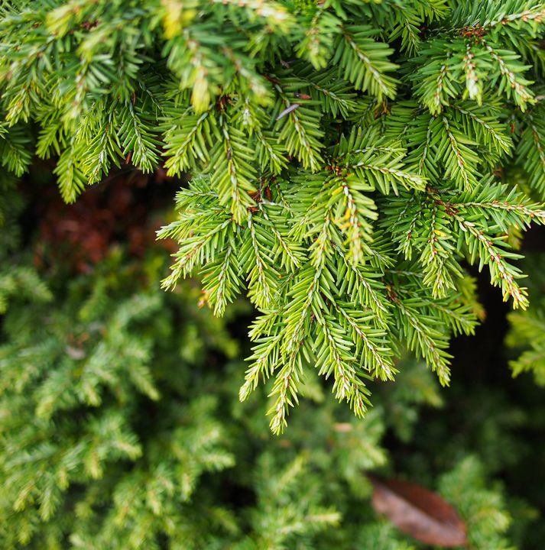
Successional dynamics in Harvard Forest
Time since last disturbance

Slide 29
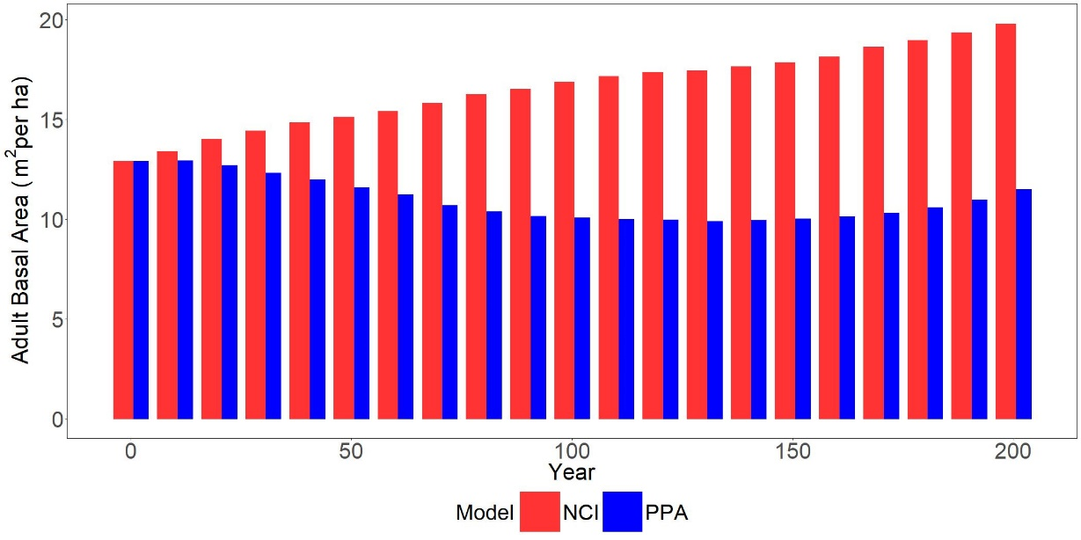
Eastern Hemlock (Tsuga canadensis)
The dominant species at Harvard Forest.
Shade tolerant: grows slow under low light conditions waiting for gaps in the canopy.
Creates lots of shade that crowds out understory tree growth.

Slide 30
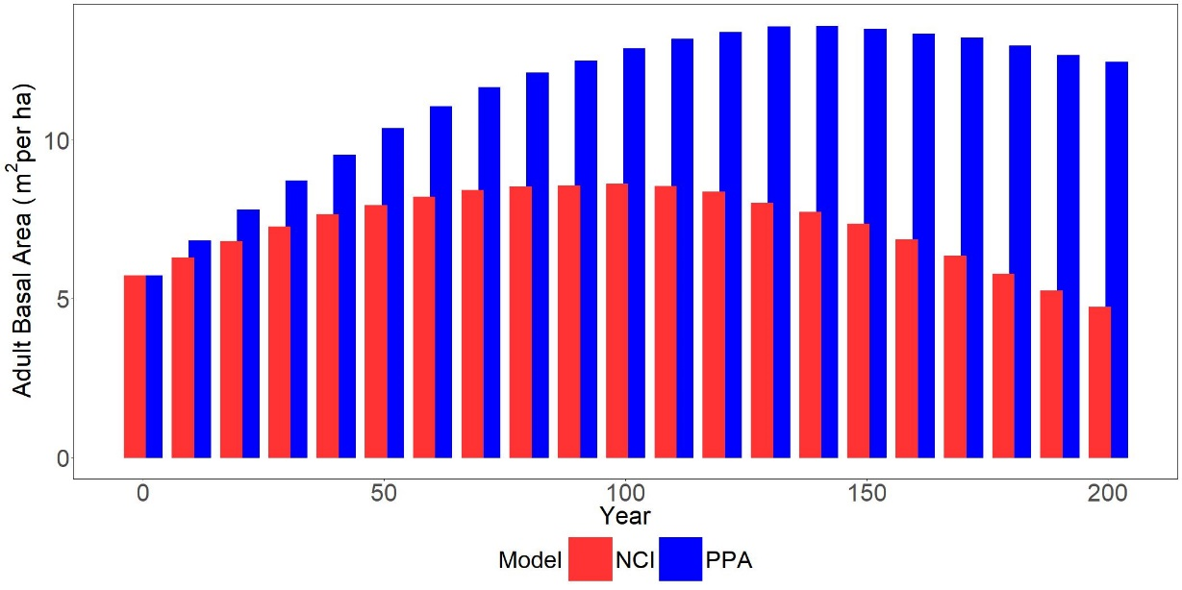
Red Maple (Acer rubrum)
Mid shade tolerant.
Often forest dense monocultures.
Can maintain itself as climax community in some conditions, but will not succeed more shade tolerant species such as eastern hemlock.

Slide 31
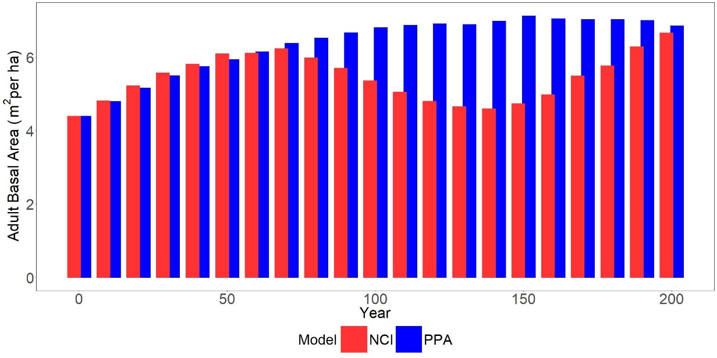
White Pine (Pinus strobus)
Early successional: can be a pioneer species but is less susceptible then most to succession due to shade tolerance.
Will not often regenerate in established forests.
Will not often outcompete more shade tolerant species without disturbance.

Slide 32
Community succession in PPA
Highly shade-tolerant species such as eastern hemlock are underperforming landscape level biomass.
Mid successional species, such as red oak and red maple are over-performing landscape level biomass.
Early successional species, such as white pine, are preforming as expected. What aspects of the model may lead to these results?

Slide 33
Parameters
Species that over-performed growth in the PPA, held no direct advantage in either lower mortality rates, higher growth rates or higher fecundity rates.
Similarly species that underperformed in the PPA, had some of the lowest mortality rates and average growth rates.
Some of the species that did best in the PPA model however, had higher allometric height coefficients.

Slide 34
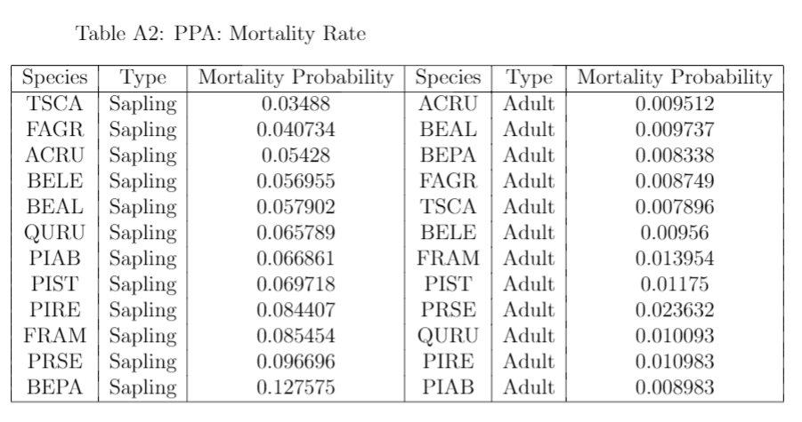
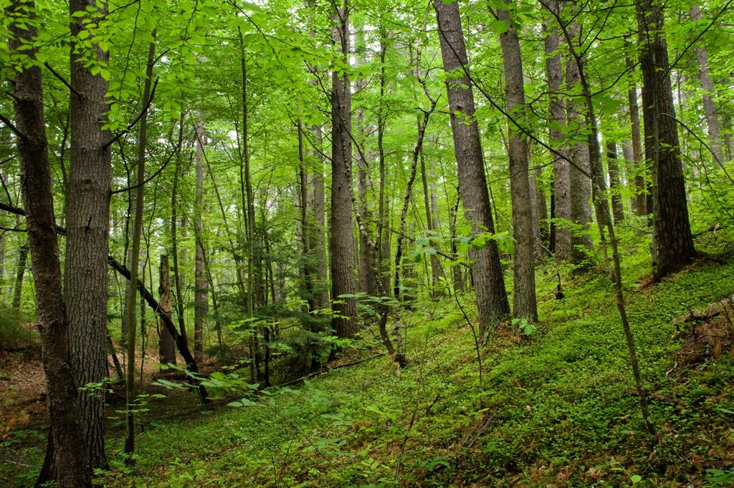
Understory growth and its impact on community composition
Each species was applied a uniform understory growth reduction (10%) of ideal.
Within the model, given much higher sapling mortality, slow sapling growth increases overall mortality.
This is not the case in nature. Species like eastern hemlock which can remain in the understory almost indefinitely.

Slide 35
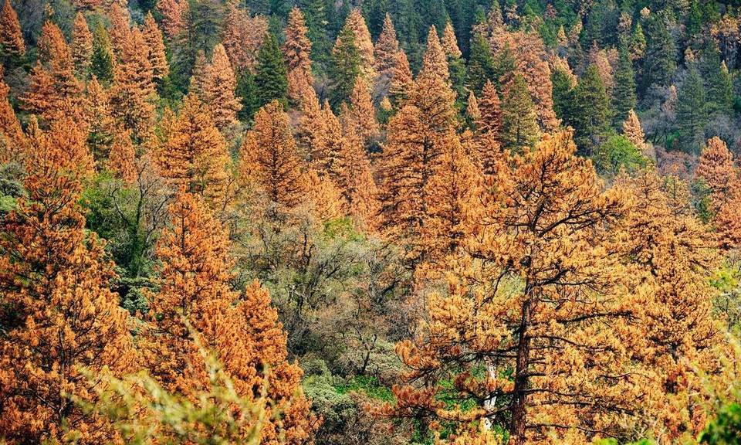
Differing methods of dispersal and mortality
The SORTIE model had more complex metrics for mortality and fecundity that may suppress red oak and maple and lead to greater hemlock dominance.
Spatially explicit fecundity can allow for greater self-replication by some species, and succession in others.
Without accounting directly for tree age, many cohorts of hemlock may have died that would have likely not in a SORTIE simulation.

Slide 36
Conclusion
Parameterization of PPA models using SORTIE-ND accurate in approximating biomass dynamics, but requires further calibration for species dynamics.
The competition mechanism within spatially explicit and implicit models can lead to different predictions of forest succession and should be accounted for.
Future simulations of the PPA need mechanisms of tree growth and mortality that account for species that are slow growing but persistent.

Slide 37
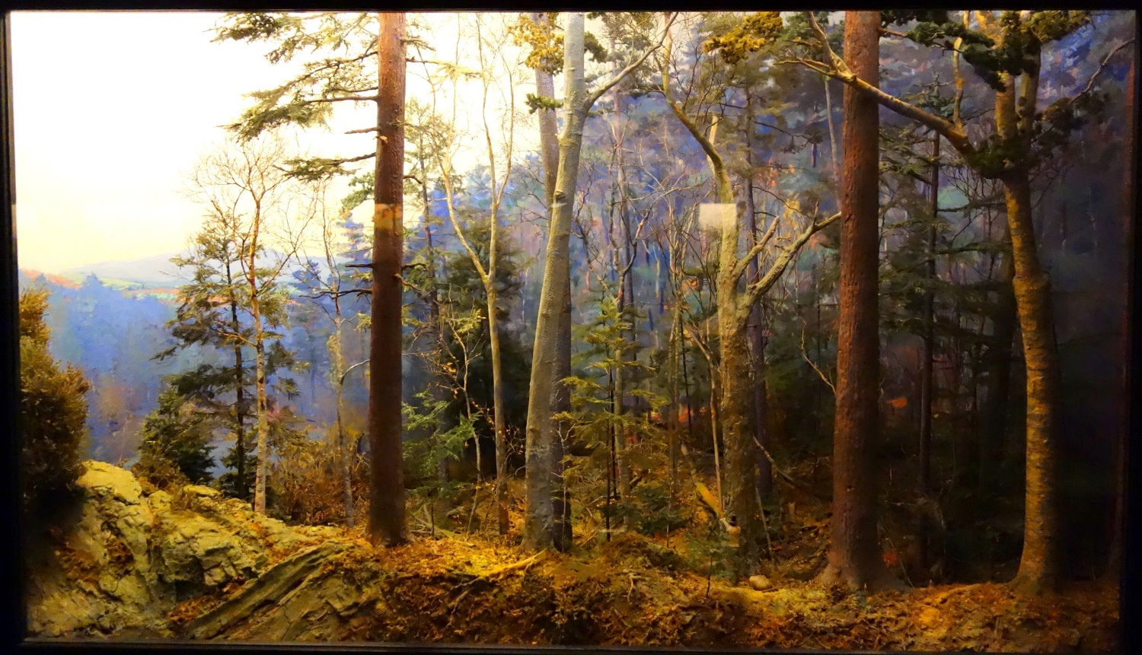



Thank you
National Science Foundation REU Program (Award #: DBI-1461057).
ESTCP Grant: Ecosystem Model Comparison at Multiple Scales and Sites
Citations: Strigul, N., Pristinski, D., Purves, D., Dushoff, J., & Pacala, S. (2008). Scaling from trees to forests: tractable macroscopic equations for forest dynamics. Ecological Monographs, 78(4), 523-545. Pacala, S. W., Canham, C. D., Saponara, J., Silander, J. A., Kobe, R. K., & Ribbens, E. (1996). Forest models defined by field measurements: estimation, error analysis and dynamics. Ecological monographs, 66(1), 1-43. Canham, C. D., Papaik, M. J., Uriarte, M., McWilliams, W. H., Jenkins, J. C., & Twery, M. J. (2006). Neighborhood analyses of canopy tree competition along environmental gradients in New England forests. Ecological applications, 16(2), 540-554.

